Slide 1
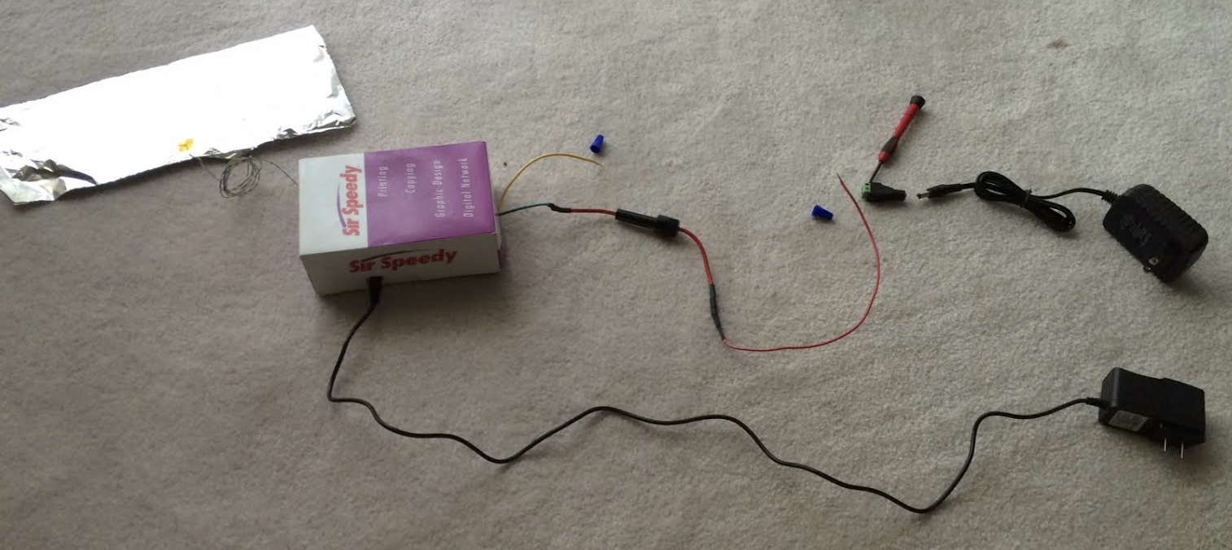
F
B1
C
G
E
B2
A
H
D
A. Connector for 12VDC Power adapter, 2A
B. Blue Wire Connector
C. Phillips head screwdriver (will not be provided)
D. 12VDC Power adapter, 1A – for Arduino
E. 12VDC Power adapter, 2A – for magnetic lock
F. Foil for Buddha
G. Yellow wire
H. Red wire
Magnetic lock is not pictured

Slide 2
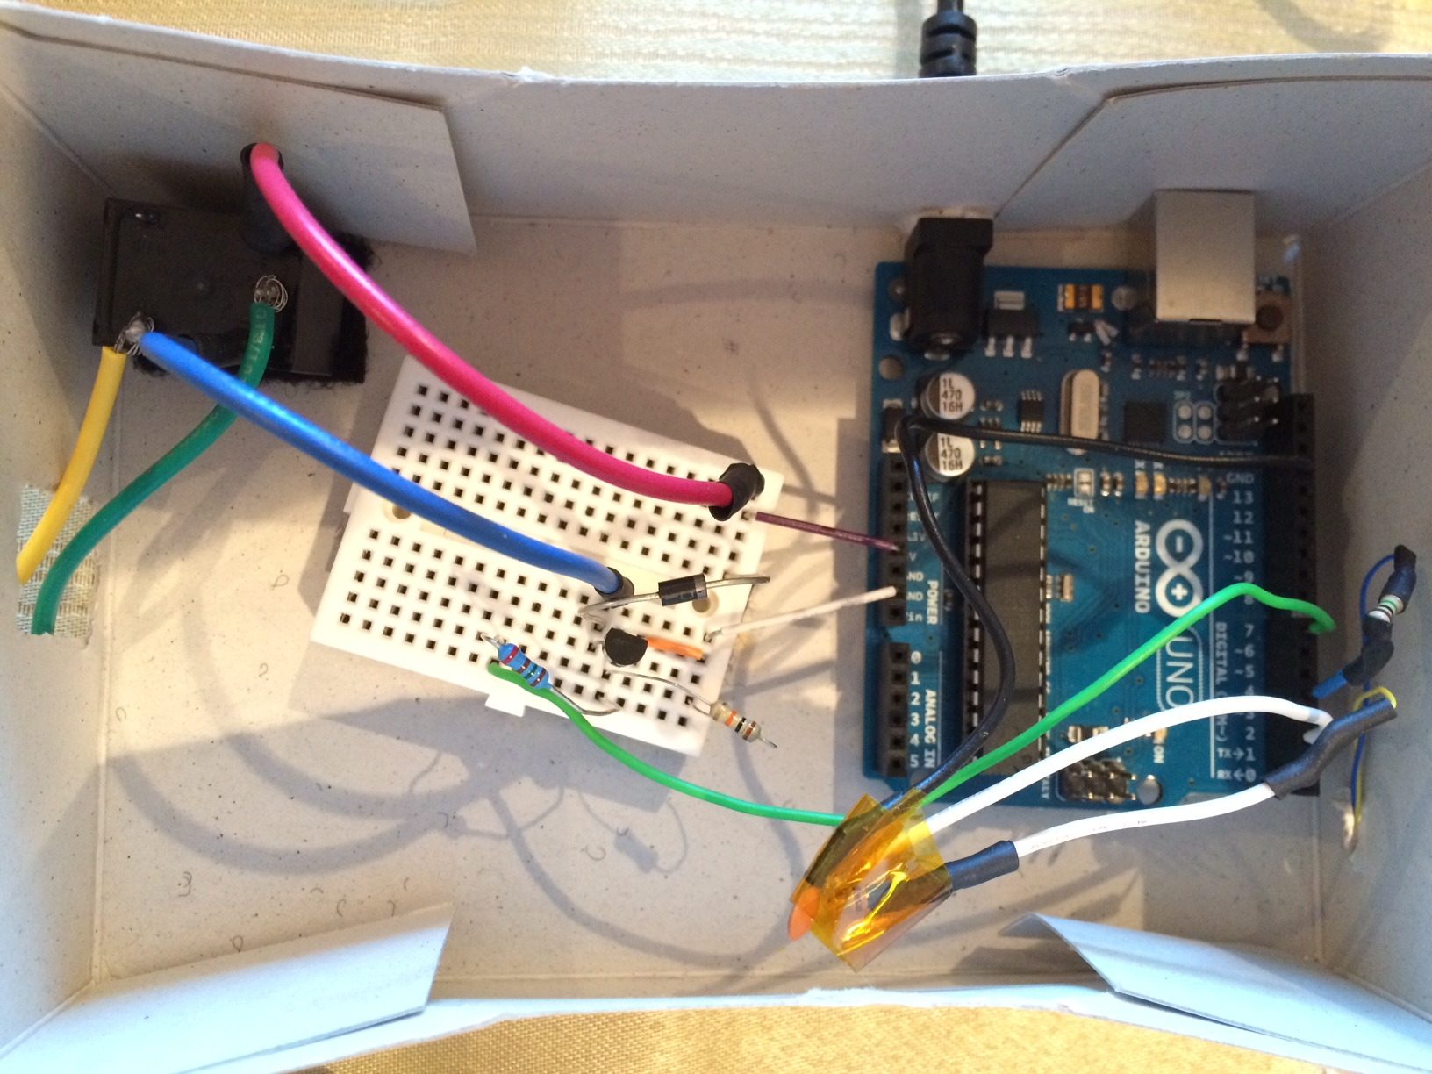
E
Breadboard
A8: Green wire
Arduino
Pin 2 <> white wire = Receive. To 1k resistor
Pin 4 <> blue wire = Send. To 1M resistor
GND <> black wire. To 100p capacitor
5.5V <> purple wire.
GND <> white wire.

Slide 3
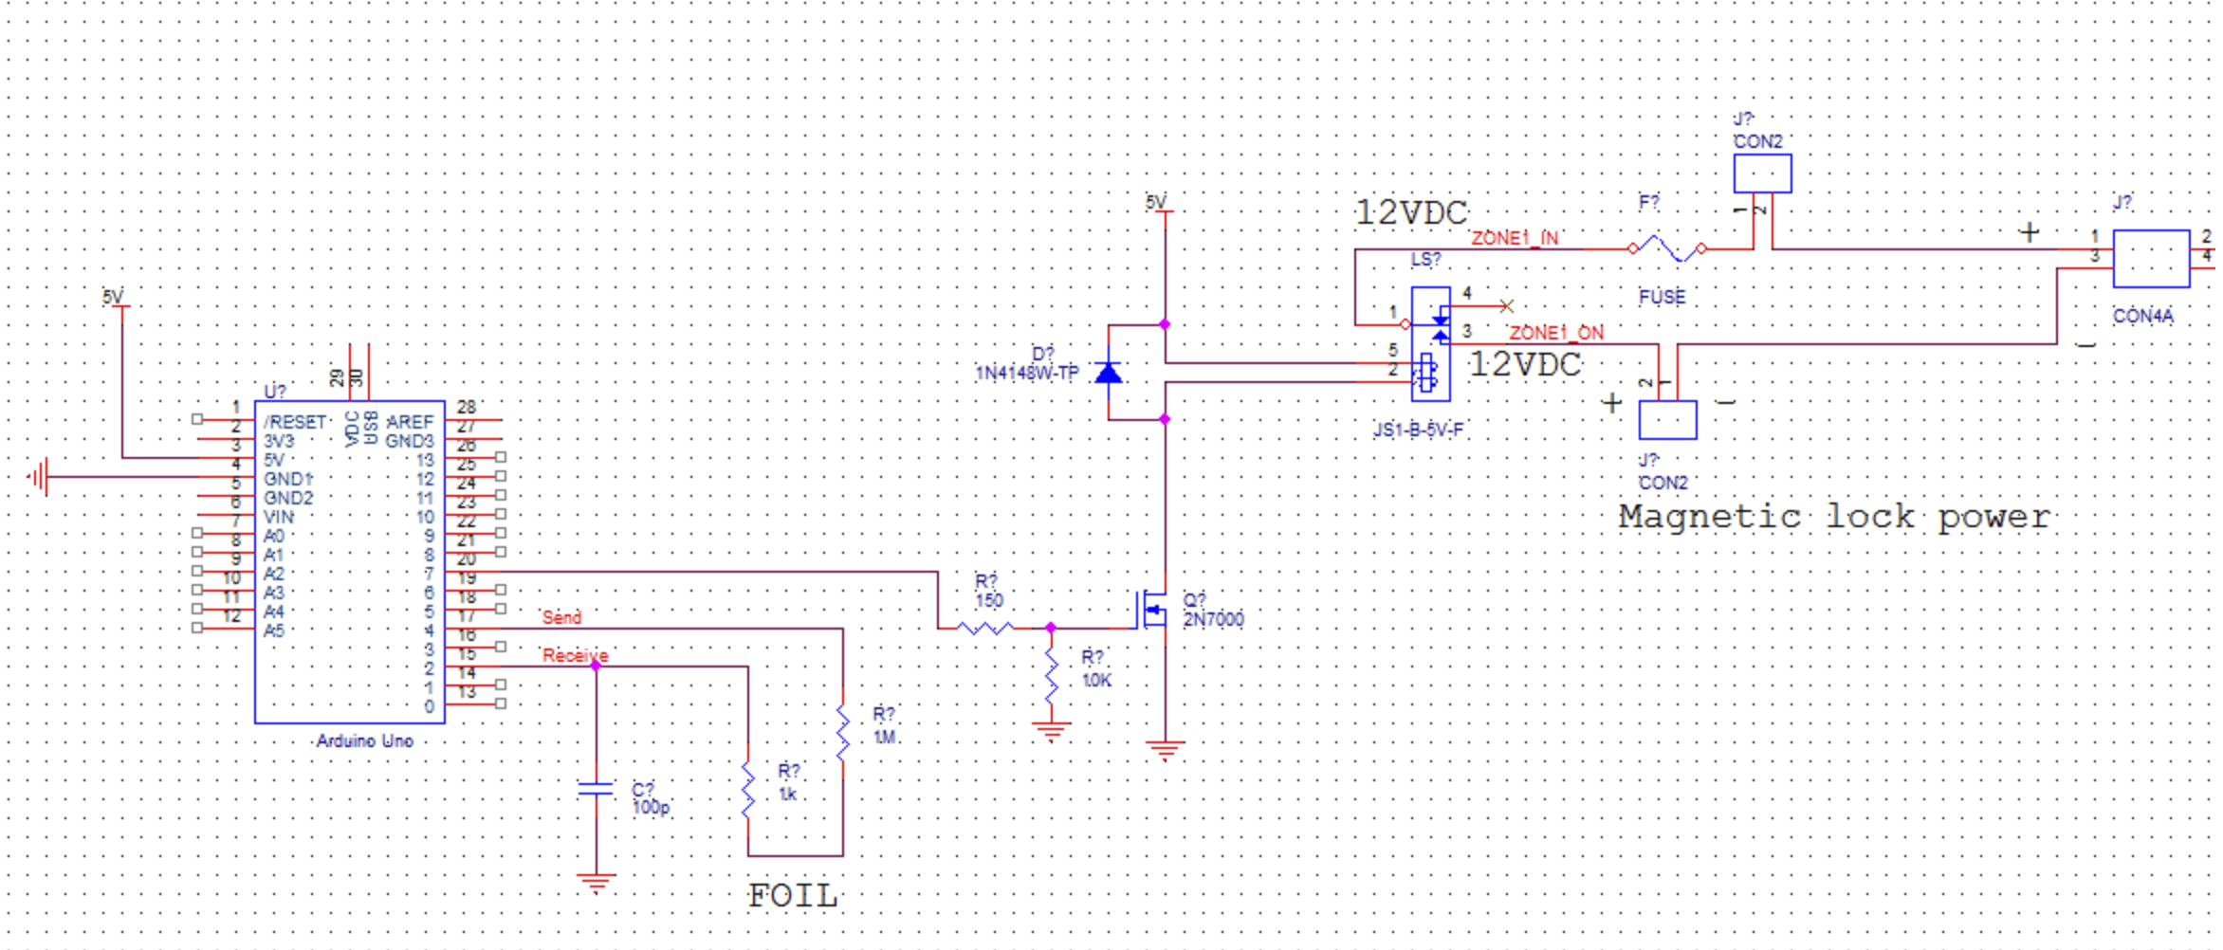
E
F17
Green
Red
Blue
yellow
D12
Green
A8
C12
Blue wire
A13
White
D14
Black
B17
D17
Blue
Yellow

